Slide 1


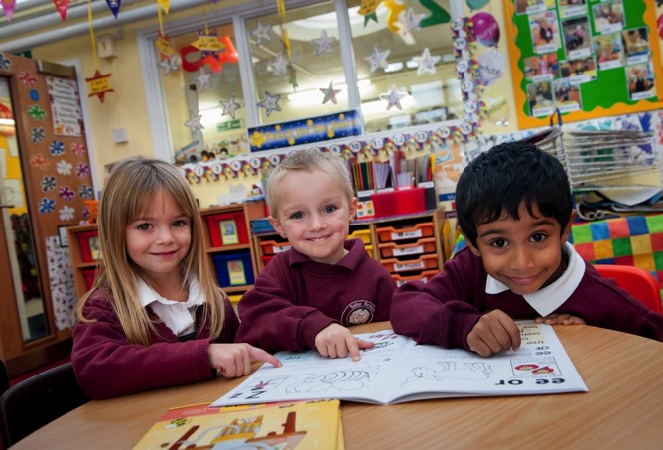
Leading the teaching of literacy
All About Jolly Phonics
Presentation for Teachers and Parents
Notes:
Jolly Phonics has been developed by practising classroom teachers.
It provides a systematic approach to teaching children how to read and write in their first year of school.
It is a synthetic phonics programme (also known as ‘systematic phonics’ in North America): the children first learn the letter sounds and are then taught to read words by ‘synthesising’, or blending, the sounds together.
This method allows children to work out unknown words for themselves, rather than being asked to memorise them. This is an important step towards independent reading.

Slide 2
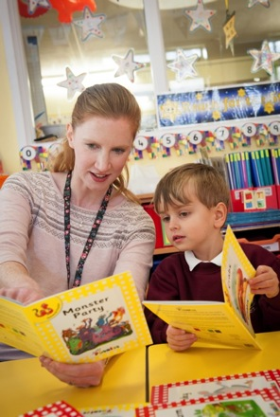
Storybooks
Reading books to children gives them:
A love of books
A wider vocabulary
A greater understanding of language
But the children need to ‘crack the code’ of English to become independent readers.
Raising Standards for All
Jolly Phonics
Presentation
Notes:
Unlike conventional storybooks, the Readers are decodable texts, which means they have been carefully written using controlled vocabulary and using only the letter sounds, spellings and tricky words that the children will know. This means the children can read them for themselves.
Storybooks are important – they give the children a love of books, enrich their vocabulary and give them a deeper understanding of how language works. But it is best to read them to the children in the initial stages and encourage them to talk about the stories.
First of all, the children need to learn how to ‘crack the code’ of comprehension, and Jolly Phonics gives children the skills to do this.

Slide 3
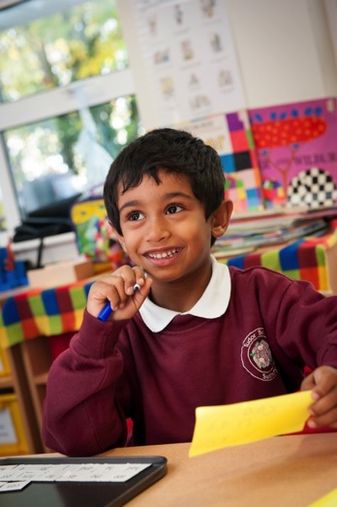
The 5 Basic Skills
The 5 basic skills of Jolly Phonics are:
1. Learning the letter sounds
2. Learning letter formation
3. Blending
4. Identifying sounds in words (segmenting)
5. Tricky words
Raising Standards for All
Jolly Phonics
Presentation
Notes:
The key to ‘cracking the code’ of the English language lies in five key skills.
The first four skills are taught together every day, right from the beginning.
‘Tricky words’, however, are introduced after about 6 weeks of teaching. By then, most of the children can work out simple, regular words for reading and writing and are ready to learn more difficult or ‘tricky’ words.
Let’s look at these five skills in more detail.

Slide 4
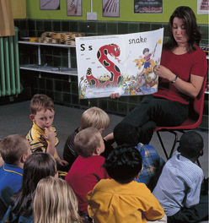
1. Learning the letter sounds
Children learn in a fun, multi-sensory way using stories and actions.
Learning the action for the /s/ sound: Weave your hand like a snake, making an ‘s’ shape, saying sssssssss.
Raising Standards for All
Jolly Phonics
Presentation
Notes:
The first step in learning to read and write is to learn the letter sounds. These are the building blocks for making words, both written and spoken.
The children are taught the letter sounds, rather than the letter names to prevent them getting muddled. Once their letter sounds are secure, they can be introduced to the letter names and capital letters.
The children are introduced to each letter sound through a story and an associated action. For example, a boy and his dog are out on a walk when the dog begins to bark. In front of them, a snake rears up out of the grass and hisses ‘ssssssss’. The hissing snake is making a ‘s’ shape. Ask the children to make the same shape, saying /sssss/. This is how they learn their first sound, /s/.* The children can also sing the song for each sound.
Children love the stories, actions and songs, all of which help them remember the letter sounds more easily.
But some children may find it difficult to learn the sounds and they will need lots of practice. There are several ways to make this fun for the children and playing games is one of them. With one or more sets of letter sound cards they can play simple but effective games like Snap or Pairs, for example.

Slide 5
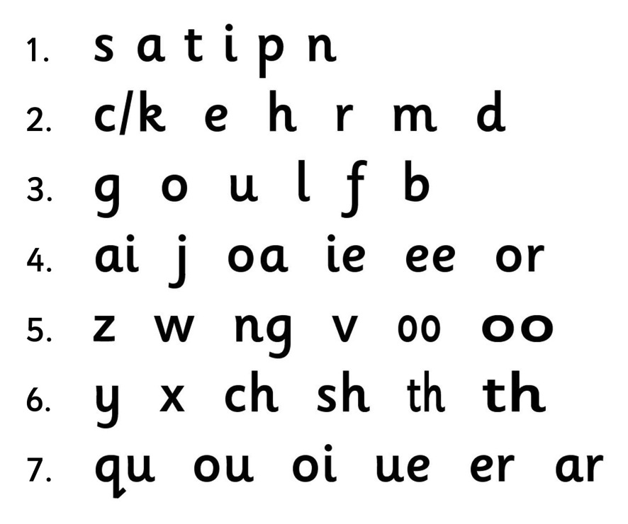
1. Learning the letter sounds – the letter sounds
Raising Standards for All
Jolly Phonics
Presentation
Notes:
Jolly Phonics teaches 42 letter sounds, divided into 7 groups.
The first group of letters contains sounds that can be put together to make many simple, three letter words. The letter sounds are taught at a challenging pace and the children can start blending (reading) words within the first week, which is hugely motivating for them.
Notice how /c/ is introduced relatively early on. This is because its letter formation is the basis for several others – /d, o, g, q/. If the children know how to write /c/, it will help them write the others more accurately.
Notice too that /b/ and /d/ are not introduced close together. This is because many children often confuse the two when forming the letters, so it is important to get them right.
Another thing to notice is that from group four onwards there are letter sounds made from two letters, called ‘digraphs’. These come later because they are slightly harder to learn, but they are introduced along with later single letter sounds because they are important to learn. Many words will be unavailable to the children if they don’t know the digraphs.

Slide 6
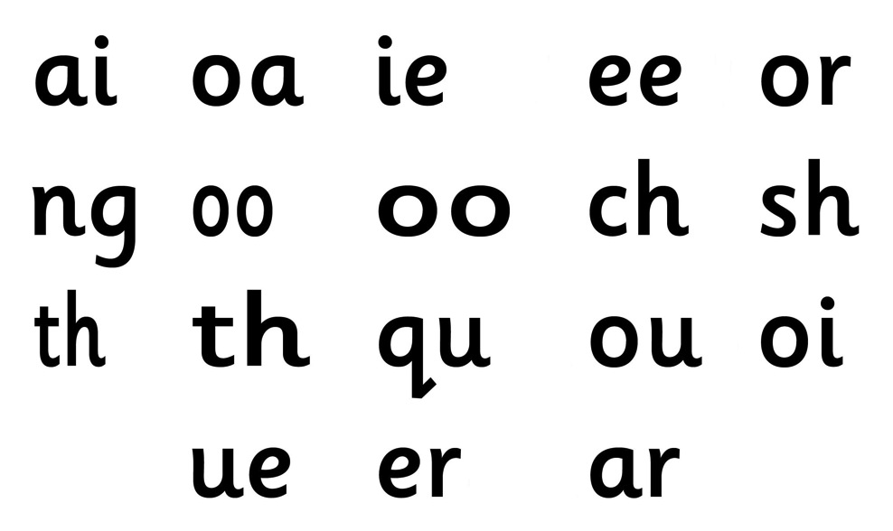
1. Learning the letter sounds – digraphs
Digraphs are two letters that make one sound.
Raising Standards for All
Jolly Phonics
Presentation
Notes:
Why do we use digraphs in written English?
The English language has 44 sounds and only 26 letters*. This means that some sounds have to be written with more than one letter. Sounds written with two letters are called ‘digraphs’.
Notice that some sounds are different but are written using the same two letters. There is /oo/ as in ‘book’ and /oo/ as in ‘moon’, /th/ as in ‘this’ and /th/ as in ‘three’. To help distinguish them, they are introduced initially in different sizes. Later on, the children will be expected to work out which sound is the right one by learning ‘if one way doesn’t work, try the other’. For example, when the children read ‘moon’, the short /oo/ doesn’t work, but the long /oo/ does.

Slide 7
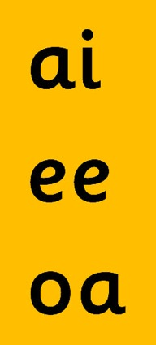
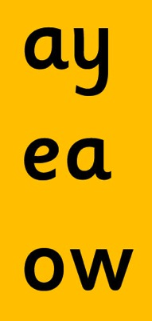
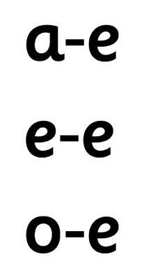
1. Learning the letter sounds – alternative spellings
The alternative spellings of the vowel sounds:
Introduced as:
Taught later as:
(play) (flame)
(rain)
(feet)
(leaf) (these)
(snow) (bone)
(boat)
Raising Standards for All
Jolly Phonics
Presentation
Notes:
Some of these sounds can be written in more than one way. For example, another common spellings of the /ai/ sound is ‘ay’, as in ‘play’. It can also be written with the ‘hop-over ‹e› digraph’ as in ‘flame’. Most of the other vowel sounds have alternative spellings too, including /ee/ and /oa/.
Once the children have mastered one way of writing the vowel sounds, they can start to learn the alternatives for reading (in the beginning, it is much easier for the children to read words with alternative spellings than it is to write them correctly).
Being able to read words with the alternatives exposes the children to a much wider vocabulary and will help them later on in their spelling, when they have to decide which alternative to use to write a word correctly.

Slide 8
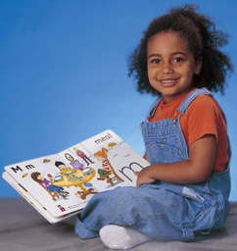
2. Letter formation
Correct formation can be encouraged from the very beginning.
Feel the letter formation
See the letter formation
Write the letter in the air
Raising Standards for All
Jolly Phonics
Presentation
Notes:
Before the children are ready to write words, they must first be able to form the letters correctly. A multi-sensory approach is used here too. From the very beginning the children need to see each letter written on the board or animated and then write each letter in the air with their finger.
They are also encouraged to think how the letters fall into different ‘types’ of formation. For example, some letters start with a caterpillar /c/ (a, d, o, g, q); some are tall letters (b, d, f, h, k, l, t); some have tails that go below the line (g, j, p, q, y, f); and some look rather similar and can be confused, particularly ‘b’ and ‘d’. Here it helps the children to use the descriptions ‘first the bat and then the ball’ (for ‘b’) and ‘up the doggy’s tail and down’ (to describe the last part of forming ‘d’).
Getting the formation correct from the very beginning will help the children when they write with a pencil and help prevent any bad habits forming (these are much harder to correct later on).

Slide 9

2. Letter formation – pencil hold
The children need to learn how to hold their pencil properly right from the start:
‘Tripod’ grip
‘Froggy legs’ movement
Raising Standards for All
Jolly Phonics
Presentation
Notes:
To encourage correct letter formation and enable neat handwriting, it is important for children to learn how to hold their pencil properly.
The ‘tripod’ grip produces the best results for both right- and left-handed children.
The pencil goes between the thumb and first (index) finger.
The next (middle) finger helps support the pencil.
The other two fingers should be tucked away.
The children move the pencil forwards and backwards by moving their knuckles in and out.
It helps the children remember how to do this if you tell them it looks like ‘froggy legs’.
[If there is time, encourage everyone to put their finger and thumb together in the tripod grip and practise making the ‘froggy legs’ movement.]

Slide 10
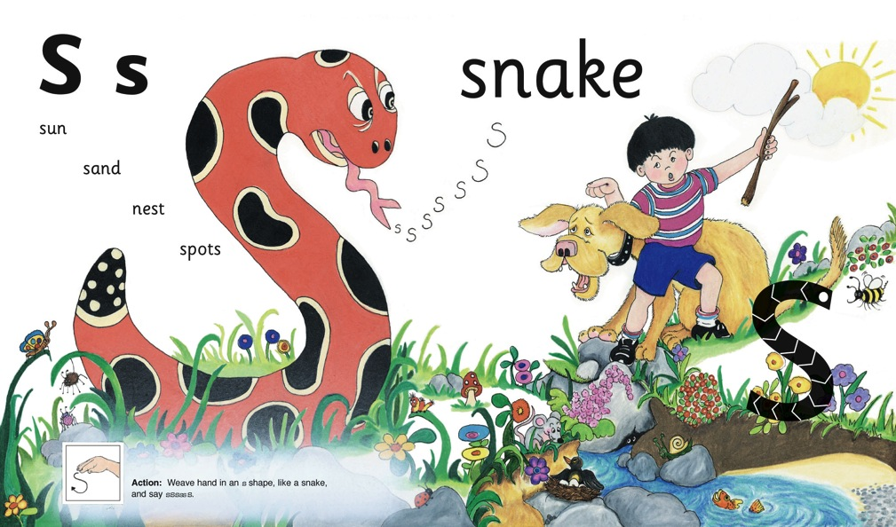
3. Blending
Blending skills are essential for reading. They can be taught right from the start.
Raising Standards for All
Jolly Phonics
Presentation
Notes:
Blending is another of the 5 basic skills. Blending is the ability to run sounds together to hear a word and is essential for reading. This skill can be encouraged from the earliest stages by asking the children, for example, “Can you see the s-u-n?”
There will be some children who can hear the word ‘sun’ straight away. They have a naturally good ear for sounds and will rarely have problems with learning to blend sounds by themselves.
But for the majority, a little practice every day will be needed for their blending to become fluent. For those children who find learning to read and write more difficult, it will take longer and they will need more individual practice.
A technique that helps all children at the beginning is to say the first sound in a word slightly louder, and then say the other sounds quickly afterwards. If you say the sounds too slowly, the children will have forgotten them by the time you finish. Don’t worry if you are almost saying the word initially, as the children need more support to begin with.

Slide 11
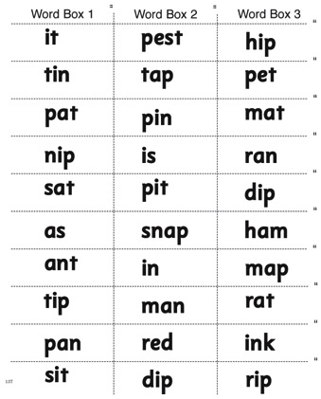
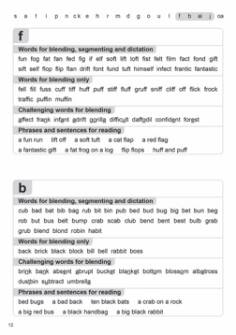
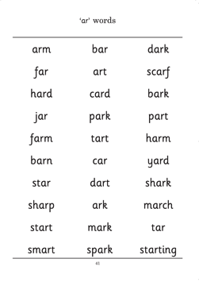
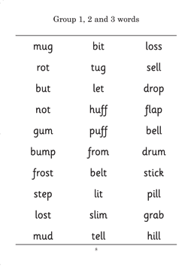
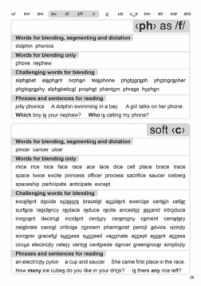
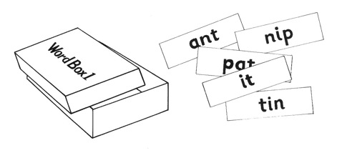
3. Blending – blending words
The number of regular words for blending grows with each new letter sound:
Jolly Phonics Word Book
Jolly Phonics Word Bank
Raising Standards for All
Word Boxes
Jolly Phonics
Presentation
Notes:
The children need to learn how to blend fluently so they can work out unknown words.
The faster the children are at blending, the easier it is for them to read.
The children should only be asked to blend words that use the sounds they already know; the blending activities in Jolly Phonics use carefully selected words at every stage.
The number of regular words available grows with each new letter sound.

Slide 12

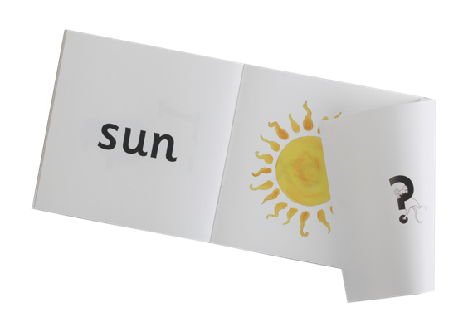
3. Blending – blending activities
Blending activities can be fun and multi-sensory:
Random letters
‘Miming’ words
Read and See books
s
c
a
p
e
n
t
i
Raising Standards for All
Jolly Phonics
Presentation
Notes:
There are several other ways to make blending practice varied and fun.
You can write random letter sounds on the board and point to different ones in turn to make a regular word. Ask the children to blend the word in their head without saying the individual sounds out loud.
You can also ‘mime’ a simple word, such as ‘tin’ using the action for each letter. The children have to guess the sound from the action and blend the sounds together in their head to make the word.
The children can also be given the Read and See books. The children enjoy working out the word and checking whether they have read it correctly by lifting the flap to see the picture.

Slide 13
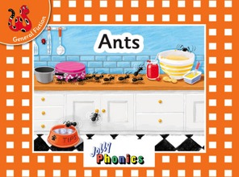

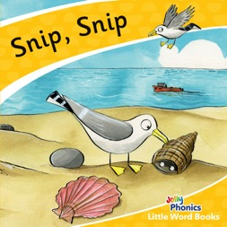
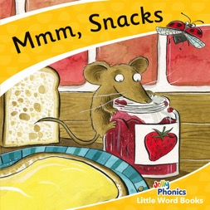
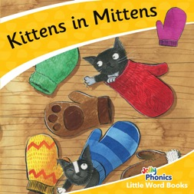

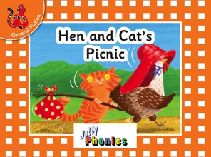
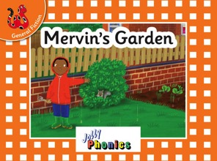
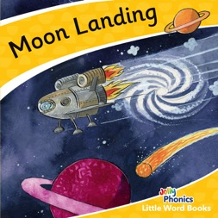
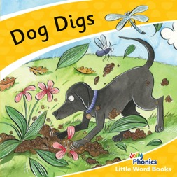
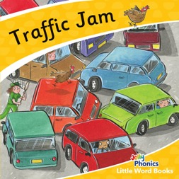
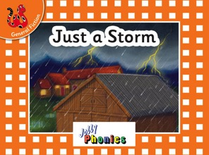
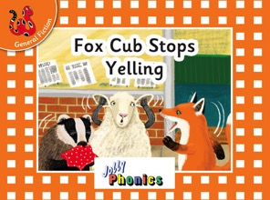
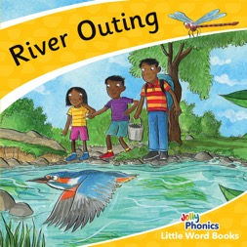
3. Blending - Jolly Phonics Decodable Readers
A wealth of interesting, decodable texts.
Raising Standards for All
Jolly Phonics
Presentation
Notes:
There are seven sets of two books in the Little Word Books, making 14 books in total, and seven sets of three books in the Orange Level 0 Readers, making 21 books in total. They are all General Fiction readers.
The books in the first set contain only regularly decodable words made up of sounds from the first set of letter sounds; the books in the second set contain only regularly decodable words made up of sounds from the first and second set of letter sounds; and so on. The final set also feature a small number of tricky words.
As children complete the 42 letter sounds and are introduced the alternative spellings and tricky words, they can progress on to Level 1 of the Jolly Phonics Readers.

Slide 14








3. Blending – blending harder words
Regular practice is the key to blending words with digraphs and consonant blends:
Digraphs
Raising Standards for All
Jolly Phonics
Presentation
Word Boxes
Notes:
Blending words with digraphs is a little bit harder for the children at first as they have to remember that when they see a word like ‘rain’, for example, the ‘a’ and ‘i’ together say /ai/.
One way to help the children is to put a dot under each sound, so the word ‘rain’ would have three dots representing the three sounds ‘r-ai-n’.
It is also easier for the children to blend words with consonant blends if they can say the consonant blend in one go: for example,
‘pl-a-n’ rather than ‘p-l-a-n’. It is worth spending time looking at the different consonant blends with the children and practising them using flashcards. (Other examples of consonant blends are ‘tr, gr, cr, dr, fl, br, scr, spl’.)
As with all the other skills, blending becomes easier with regular practice.

Slide 15
4. Identifying sounds in words – phonological awareness
Phonological awareness can be encouraged from the very first lesson:
Raising Standards for All
Jolly Phonics
Presentation
Notes:
As well as learning the skills for reading, the children must learn the skills for writing. In order to write down a regular word correctly, the children must listen to a word, identify the sounds in it and choose the letters to represent them.
The ability to hear the sounds in a word is called ‘phonological awareness’ and can be encouraged from the very first lesson. When the children are being introduced to the sound /s/, for example, they can be asked “Is there a /s/ in ‘sun’?”, “Is there a /s/ in ‘snake’? “Is there a /s/ in ‘mouse’?” “Is there a /s/ in ‘dog’?”
Most children find it difficult to hear the sounds at first and will often give the wrong answer; gradually, with practice, they will start to hear them. Those children who can hear the sounds will find it easier to hear the /s/ in ‘sun’ and ‘snake’ than in ‘mouse’ because it is the initial sound. ‘I-Spy’ is a good game to play with the children to help them hear the initial sound in words.

Slide 16

4. Identifying sounds in words – hearing the sounds
Lots of practice is needed before children can identify all the sounds in words:
Sounding out words
Word families
Removing the first sound
Chopping game
Raising Standards for All
Jolly Phonics
Presentation
Notes:
Over time it is important that the children learn to identify all the sounds in a word and this can be encouraged roughly once the children know the first six sounds.
The main way to encourage this skill is to call out a word and then sound it out with the children: for example, “hat, h-a-t”. The children are encouraged to say it again, holding up a finger for each sound. In time, most children will be able to do this for themselves.
Other ways to encourage the children to listen for sounds is to look at word families (eg cat, hat, bat, fat, rat) or play games that require losing one or more sounds in a word.
Call out ‘pink’ for example and the children should respond with ‘ink’; ‘mice’ with ‘ice’; ‘stop’ with ‘top’.
Or call out a whole word and ask the children to take away one sound at a time, until only one sound is left: for example, ‘splash, plash, lash, ash, sh’. This is called the ‘chopping game’.

Slide 17
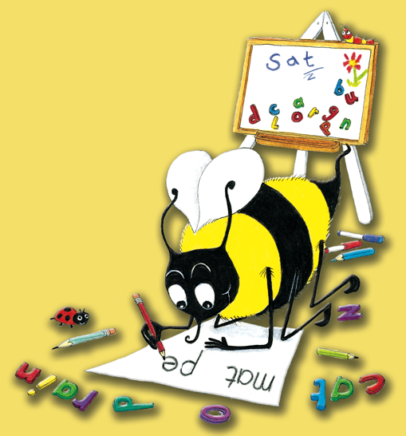
4. Identifying sounds in words – dictation
Dictation practice prepares the children for independent writing:
Letter sounds
Simple CVC words
Regular words with consonant blends and digraphs
Phrases and sentences
Capital letters
Raising Standards for All
Jolly Phonics
Presentation
Notes:
Once the children are able to hear the sounds in words and know how to write them, they are ready for some simple dictation.
First of all, letter sounds are dictated, followed by simple CVC words (consonant-vowel-consonant words eg ‘cat’, ‘hop’, ‘tin’.)
When the children can do this, they are ready for longer, more complicated words (such as compound words or words with digraphs and consonant blends).
Then they can move on to short phrases and eventually sentences, where they need to know that a sentence starts with a capital letter and ends with a full stop, and that the letters in the words should not bump up too close together but that there should be a gap between each word.
By this stage it is a good idea to give some regular dictation on capital letters. The children find it quite easy to recognise them, but also need to know how to write them.

Slide 18
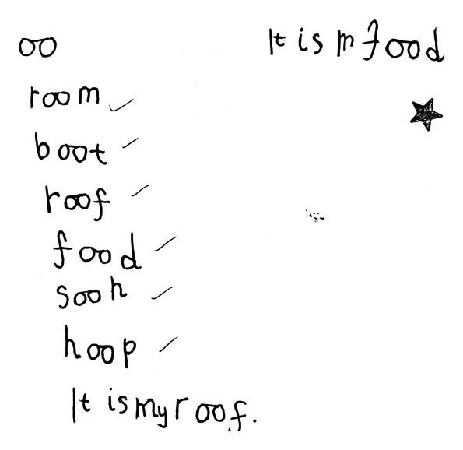
4. Identifying sounds in words – simple dictation
A sample of early dictation by a five-year-old using Jolly Phonics.
Raising Standards for All
Jolly Phonics
Presentation
Notes:
Here is a typical sample of some early dictation.
It was written by a five-year-old in the first half of the year.

Slide 19
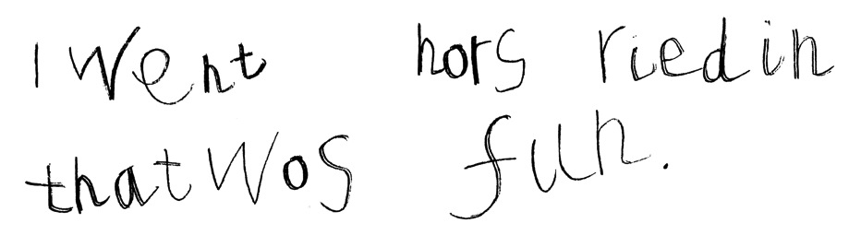
4. Identifying sounds in words – independent writing
For children to write independently they need to know:
The 42 letter sounds
How to hear the sounds in words
One way of writing the letter sounds
What they want to say
Raising Standards for All
Jolly Phonics
Presentation
Notes:
Once the children are able to write words and little sentences, they are ready to try some independent writing; it usually looks like this.
At this stage, the children’s spelling will not be accurate but their work can be read.
Most of the words have been sounded out successfully and written using the spellings they know.
This child needs to listen carefully to hear the /ng/ at the end of ‘riding’.
The silent ‘e’ in ‘horse’, the long ‘i’ in ‘riding’ and the tricky word ‘was’ will be taught later.

Slide 20
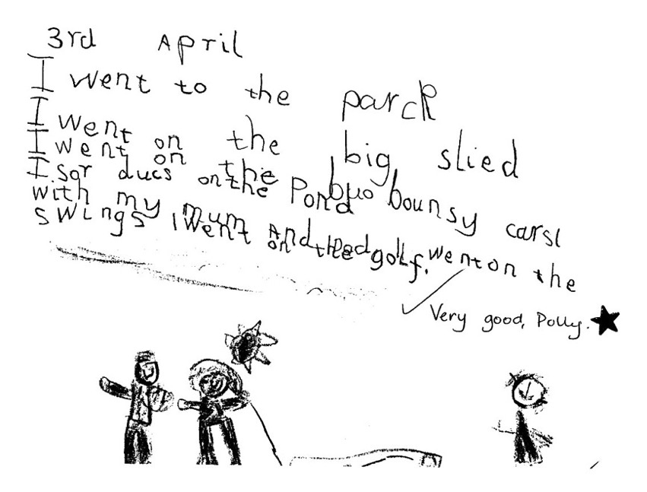
4. Identifying sounds in words – independent writing
Independent writing towards the end of the first year:
Raising Standards for All
Jolly Phonics
Presentation
Notes:
Here is a typical example of the kind of writing a five-year-old will do towards the end of their first year.
Children who find it difficult to learn their letter sounds or hear the sounds in words will not be as far on as this.
With practice they will get to this stage, but it will take a bit longer.
In their first year it gives the children enormous confidence and pleasure to be able to write down exactly what they want and be understood.

Slide 21
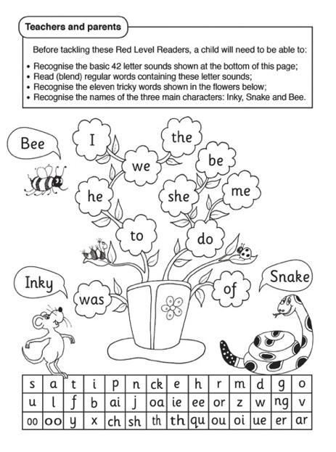
5. Tricky words
To read tricky words well, the children need to:
Work out the ‘tricky’ bits
Have regular flashcard practice
Raising Standards for All
Jolly Phonics
Presentation
Notes:
Not all words in English can be written successfully by listening for the sounds, as some words have irregular spellings or use alternative spellings that the children haven’t learnt yet.
Some of these words, like ‘I, the, he, she, me, we, be, was, to, do, are, all’ are words that the children need to know if they are going to read and write sentences.
These words are called ‘tricky’ words because they are inclined to trick you!
In Jolly Phonics, the children are taught 72 tricky words, which they have to learn by heart.
Not all of the word will be tricky, and the children find it amusing to blend it and work out which bit is the tricky part.
Analysing the words and having regular practice with flashcards is the best way for children to learn to read the tricky words.

Slide 22
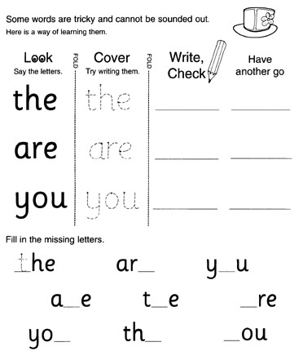
5. Tricky words
To write tricky words well, the children need to learn the following techniques:
Look, copy, cover, write and check
Say it as it sounds
Mnemonics: ‘o u lucky duck!’
Word families
Raising Standards for All
Jolly Phonics
Presentation
Notes:
The children find it easier to read the tricky words than to spell them, so a range of techniques can be employed to help the children learn the spellings.
The main method is called ‘Look, Copy, Cover, Write and Check’. First of all, the children look at the word and think about how it is spelt. They could analyse the word as they did for reading, or repeat the letter names several times, or even form each letter in the air as they say its name. Then they copy the word, cover it up and try writing it on their own. Finally they check what they have written against the tricky word and have one more go.
Another effective technique is to say the tricky word as it sounds. So the word ‘Monday’, for example, would be remembered as ‘MON-day’, and ‘Wednesday’ as ‘Wed-NES-day’ to help the children remember the spelling.
For words that are much harder to spell, mnemonics are very useful. “People’ can be remembered as ‘people eat omelettes, people like eggs”; ‘because’ by ‘big elephants catch ants under small elephants’. The ‘ould’ in words like ‘could, should, would’ can be remembered as ‘o u lucky duck’.
It is also helpful to link tricky words to their word families. For example, once the children have learned the tricky word ‘all’, they should find it easier to spell words like ‘call, fall, ball, hall, tall, wall’.

Slide 23
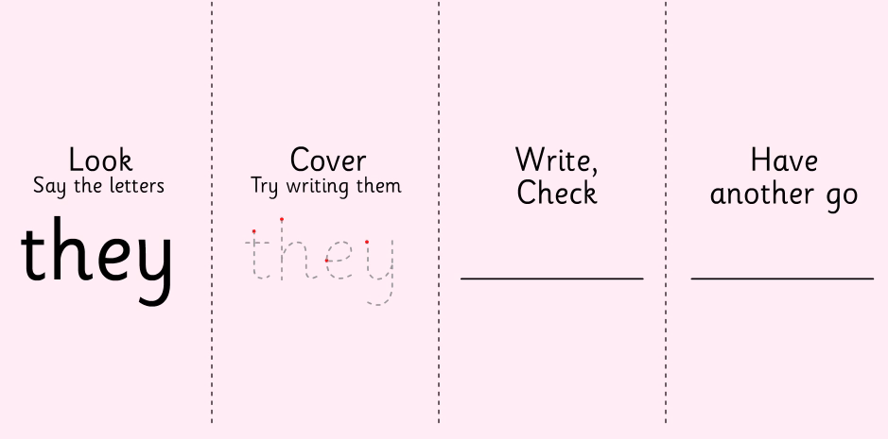
5. Tricky words
‘Look, copy, cover, write and check’ is a good way to learn how to write tricky words.
Raising Standards for All
(Click image to play animation.)
Jolly Phonics
Presentation
Notes:
This animated example of the ‘look, copy, cover, write and check’ technique comes from Jolly Phonics for the Whiteboard.
Firstly, the class practice reading each word by working out the tricky bit.
Then they look at how to write each word.
First they say the letter names a few times and then they go through the animation
When this has finished, individual children can come to the front to have a go themselves.

Slide 24

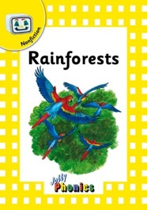
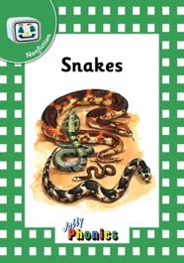
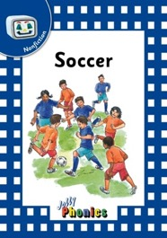
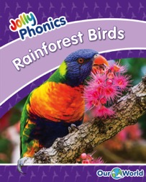
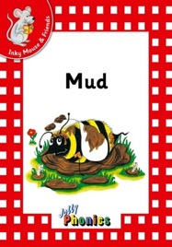
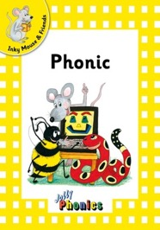
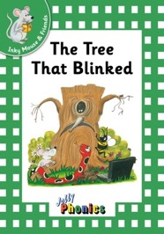
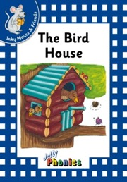


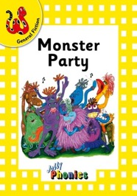
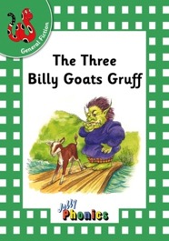
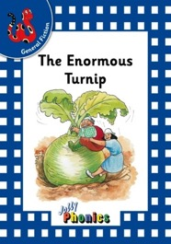
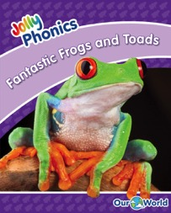
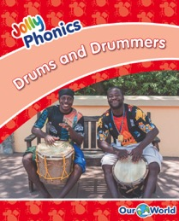

Jolly Phonics Decodable Readers – Levels 1 - 5
A wealth of interesting, decodable texts.
Raising Standards for All
Jolly Phonics
Presentation
Notes:
The Readers are decodable texts, which means they have been carefully written using controlled vocabulary and using only the letter sounds, spellings and tricky words that the children will know. Because Jolly Phonics teaches the digraphs and tricky words early on, the texts are lively and interesting from the start.

Slide 25




Jolly Phonics Decodable Readers
Guidance for teachers and parents, including comprehension questions
(Level 5: Purple Readers)
Variety of interesting and engaging stories in decodable language
Guide to the letter sounds and tricky words needed for each book
Raising Standards for All
Jolly Phonics
Presentation
Notes:
Guidance for teachers and parents, along with comprehension questions are also included at the back of each book.
As a guide, light type is used for those letters that should not be sounded out, such as the ‘e’ in ‘are’. This allows for a greater variety of text and exposes the children to words they would not otherwise come across in their lessons.

Slide 26









Jolly Phonics Decodable Readers
Raising Standards for All
Jolly Phonics
Presentation
Notes:
Here you can see how the other levels have been graded.
Notice how, from the red Level 1 readers, the number of pages in each book increases per level, along with the tricky words and number of sentences per page. Notice too that no alternative spellings are introduced until Level 3, when the ‘hop-over ‹e› digraphs’ are introduced (as in ‘cake, these, time, stone, cube’).
The rest of the alternative spellings are introduced in Levels 4 and 5.
Once the children have read all levels of the Readers, they are ready to start reading normal storybooks and other more challenging texts.

Slide 27



Parental support
Providing additional support at home can help children achieve the best results:
Sound sheets
Sound books
Word boxes
Dictation
Jolly Phonics Readers
Raising Standards for All
Jolly Phonics
Presentation
Notes:
Parents can play an important role in helping their child to learn to read and write.
Some parents like to make a file of all the sound sheets their child has done. This can be used for revision for the child and also helps the parents remember the actions and sounds.
Also, as each sound is taught, it is stuck into a Sound Book. This can be taken home for the parents to practise with their child.
Similarly, strips of words can be sent home for dictation practice. Parents can encourage their child to listen for the sounds in the words to help them write the words correctly.
Parents can also help their child to become independent readers by encouraging him or her to work out the words in the Readers and to check that their child knows the tricky words.

Slide 28
First year timetable
First term | Second term | Third term
Teach the 42 sounds | Introduce letter names Teach alternative spellings | Revise alternative spellings
Teach how to form the letters correctly | Teach handwriting rules and give writing practice | Give handwriting practice
Teach how to blend simple regular words | Introduce the Readers Practice blending words with alternative spellings | Continue with Jolly Readers and blending practice
Teach how to write words by listening for sounds | Give regular dictation of words and sentences | Continue regular dictation Encourage independent writing
Teach how to read and write the first set of tricky words | Teach the reading and writing of more tricky words | Ensure the children know the first 72 tricky words
1
2
3
4
5
Raising Standards for All
Jolly Phonics
Presentation
Notes:
Here is a suggested schedule for the the first year of learning to read and write.
It shows all the different elements needed for independent reading and writing.
In the first part of the year (about 9 weeks), it is important to make sure the children learn how to blend simple regular words, including those with digraphs (and not just CVC words).
Every day there should be some practice of blending and writing regular words, including words with the digraphs that have already been taught.

Slide 29

Sample first year checklist
Raising Standards for All
Jolly Phonics
Presentation
Notes:
It is important to know how individual children are progressing and, if there is a problem, to know which areas they are having difficulty in.
Reading ability can also be observed with age-appropriate books and texts – for example, do the children read slowly, steadily or fluently? Are they able to write news or short stories independently?
There are other ways to keep track of the children’s progress and it is best to use whichever method is most suitable for the circumstances.

Slide 30

Leading the teaching of literacy
Systematic approach
Fun, multisensory teaching
Range of age-appropriate materials
7 years’ literacy teaching
Enables confident, independent learning
Raising Standards for All
Jolly Phonics
Presentation
Notes:
• So what is the best way to sum up Jolly Phonics?
• The programme provides a systematic approach to teaching reading and writing in a fun, multi-sensory way.
• There is a wealth of different materials available for both school and home, all focused on developing the five key skills needed for
successful reading and writing.
Further Information
• For those who would like to learn more about Jolly Phonics, there are are several ways to get further information:
There is a catalogue and you can also order one or more free parent/teacher guides
You can order products on line and find out lots of useful information at www.jollylearning.co.uk

Slide 31


Print or precursive
Jolly Phonics materials are available in both precursive and print letters:
Precursive letters have joining tails to encourage cursive writing.
Print letters are standard letters, without joining tails.
Raising Standards for All
Jolly Phonics
Presentation
Notes:
This is an extra page to enable you to explain the difference between precursive and print letters, if asked.
The main font used in Jolly Phonics is a precursive one, which means each letter has a ‘joining tail’ or ‘exit stroke’.
This prepares the children for joined-up (cursive) writing.
Joined handwriting helps children develop greater fluency in their writing and encourages better spelling: the children feel how the letters go together by writing in one fluid movement and this reminds them to put the letters in the correct order.
However, the Jolly Phonics materials are also available in a different font for those schools who prefer to use letters without joining tails, and these are easily identified as being ‘in print letters’.

Slide 32




Contact
Jolly Learning Ltd
Tailours House,
High Road,
Chigwell,
Essex,
IG7 6DL
(T) +44 20 8501 0405
(F) +44 20 8500 1696
(E) info@jollylearning.co.uk
(W) www.jollylearning.co.uk
Social Media:
@Jolly Learning
Raising Standards for All
Jolly Phonics
Presentation

